Slide 1
Credit EDA Assignment
By Suraj Atkare
Batch ID: 1970
Program: upGrad & IIITB | Data Science Program - October 2021

Slide 2
Problem Statement
Global Mart is an online supergiant store that has worldwide operations. This store takes orders and delivers across the globe and deals with all the major product categories — consumer, corporate and home office.
As a sales manager for this store, you have to forecast the sales of the products for the next 6 months, so that you have a proper estimate and can plan your inventory and business processes accordingly.

Slide 3
Available Data
Global+Superstore+Data.csv' contains all the information related to sales, profit, different markets and segments

Slide 4
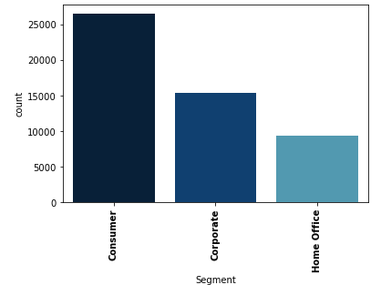
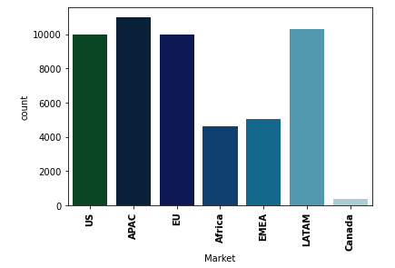
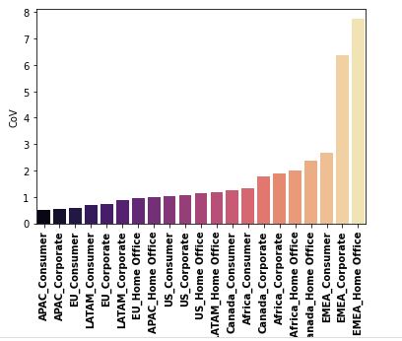
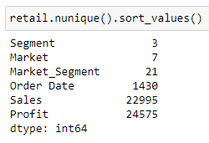
Analysis
Data provided has 3 segments, 7 different markets and 21 market-segment

Slide 5
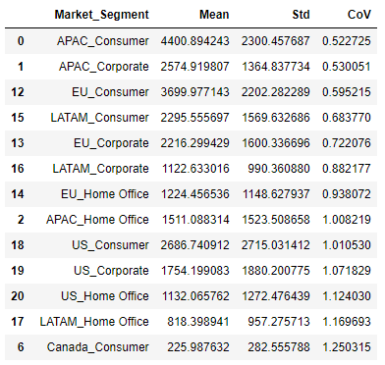
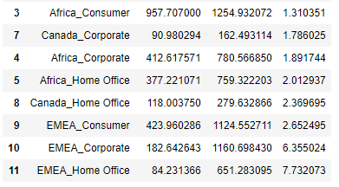
Analysis
"Coefficient of Variation (CoV)". The coefficient of variation or CoV is nothing but the ratio of the standard deviation to mean for the data that it is being calculated for.
For the calculated data it can be observed that APAC_Consumer is the most profitable market segment.

Slide 6
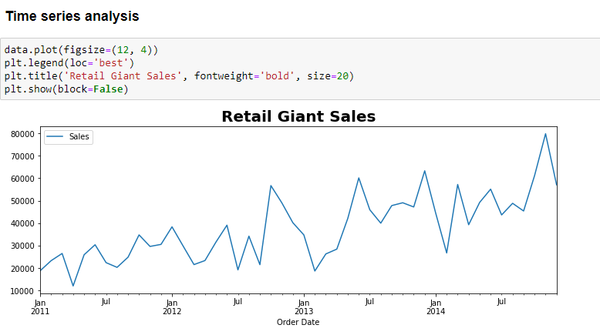
Analysis

Slide 7
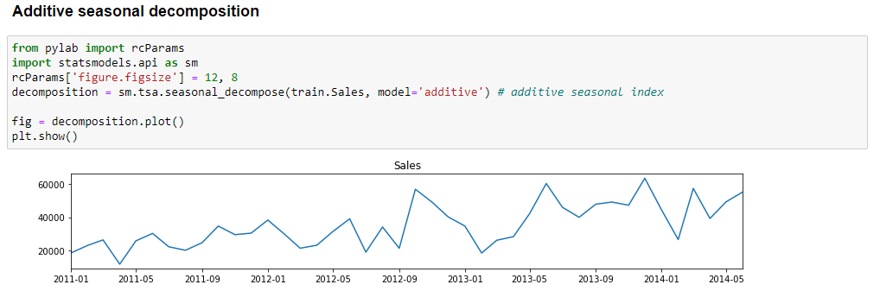
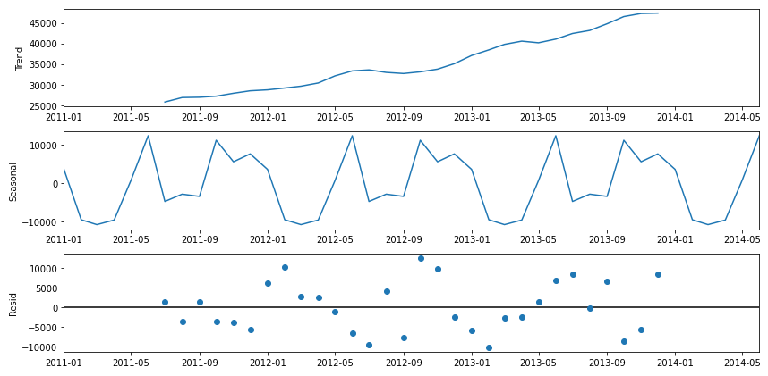
Analysis

Slide 8
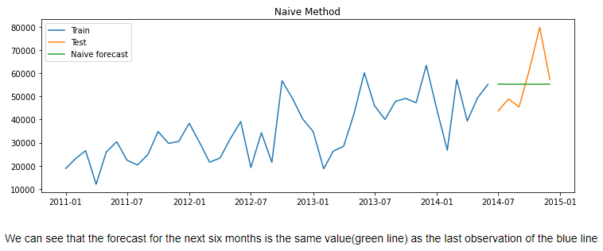
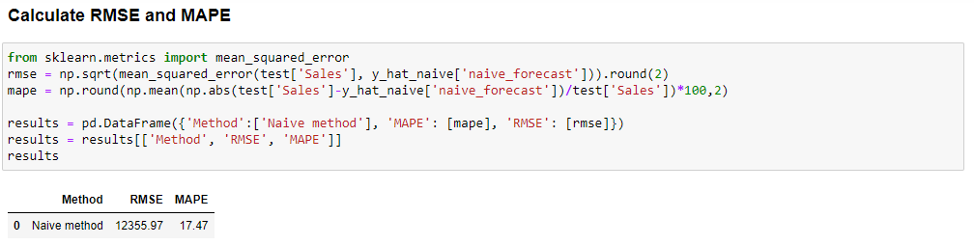
Simple Time Series Methods

Slide 9
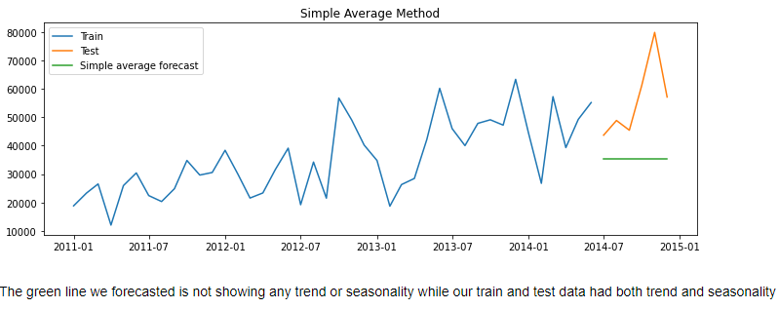
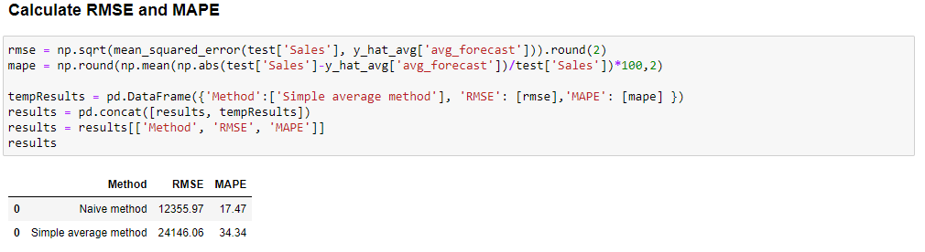
Simple Time Series Methods

Slide 10
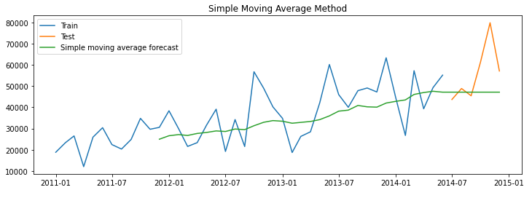
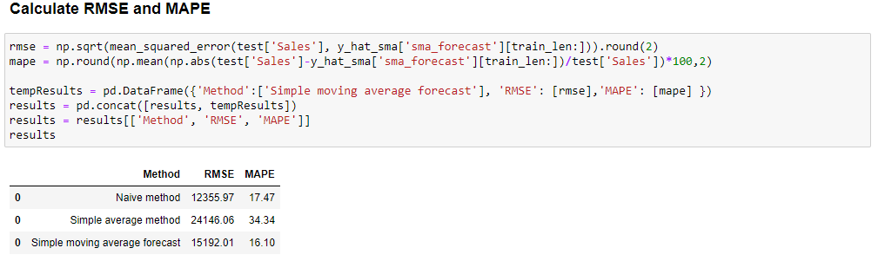
Simple Time Series Methods

Slide 11
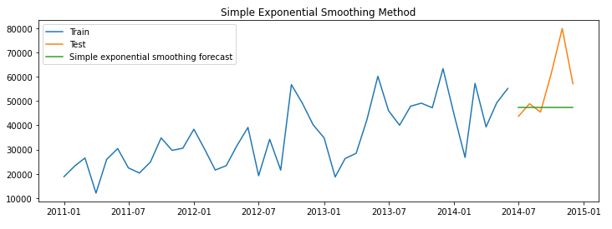
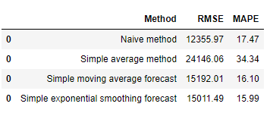
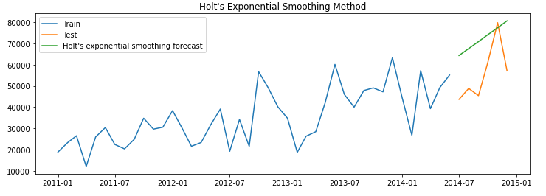
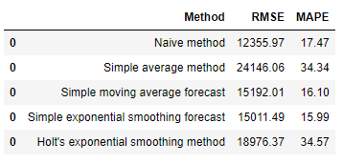
Simple Time Series Methods

Slide 12
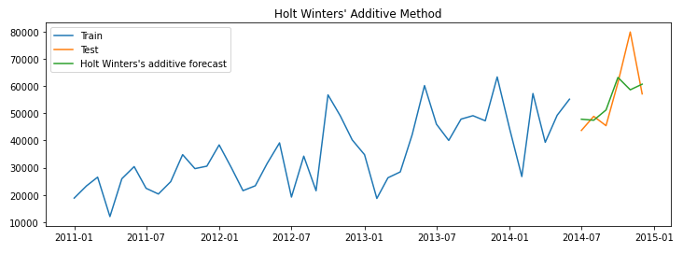
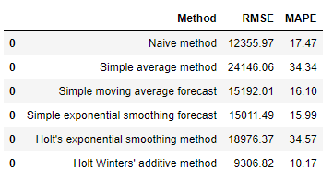
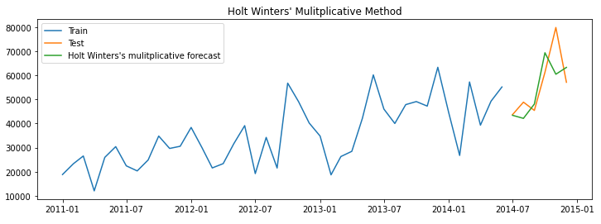
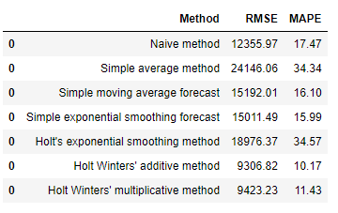
Simple Time Series Methods

Slide 13
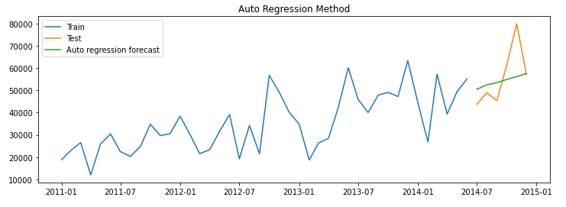
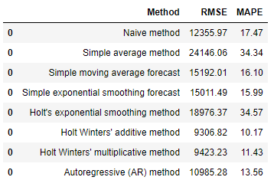
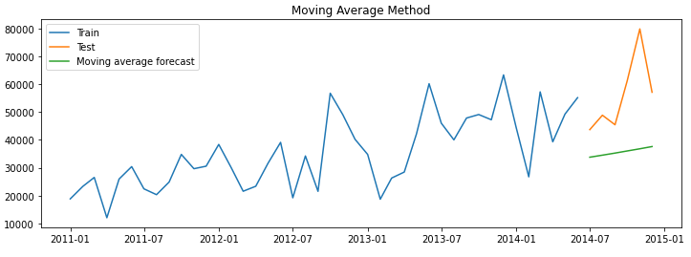
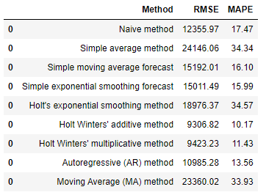
Auto Regressive Methods

Slide 14
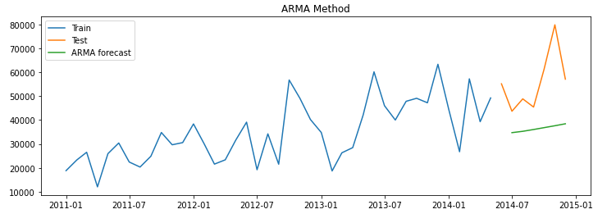
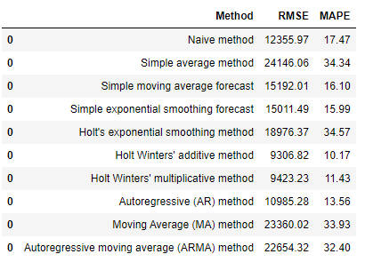
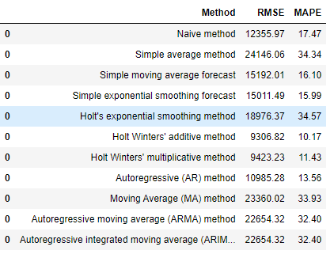
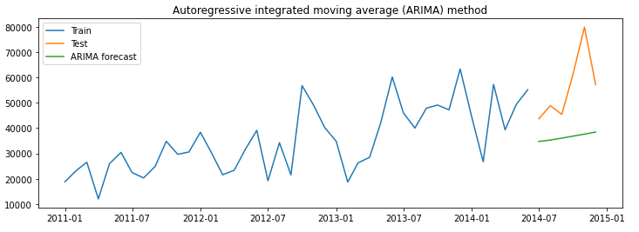
Auto Regressive Methods

Slide 15
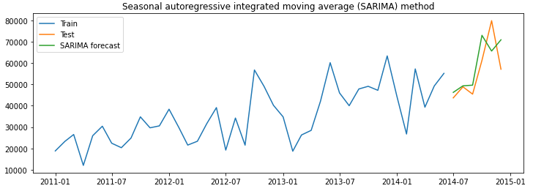
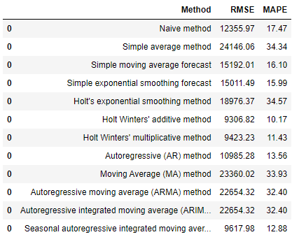
Auto Regressive Methods

Slide 16
Conclusion / Suggestions
Holt Winters additive method is the best forecasting method in the smoothing technique
SARIMA - Seasonal Autoregressive Integrated moving average is the best method in ARIMA set of techniques.

